Slide 1
Early Fire Warning System
Intro to Software Engineering Final Project

Slide 2
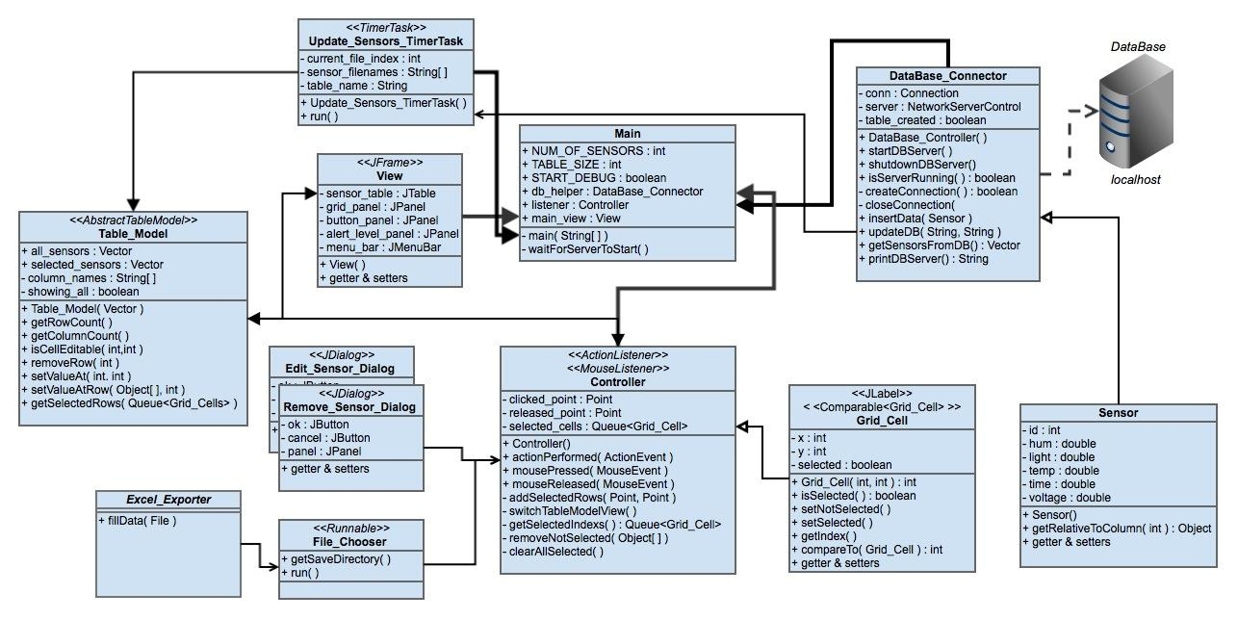
Notes:
This is the uml diagram for our early warning fire system.

Slide 3
Basic Program Lifecycle
1. Start database server
2. Create a new database connection
3. Create the GUI
4. Start simulated stream of data
5. Read new data at set interval
6. Respond to user actions

Slide 4
Starting the Database Server
DataBase_Connector.java
Uses derby.jar, derbyclient.jar, and derbynet.jar to start a server on “localhost” programmatically.
Creates a new database called, “SensorDB” if it doesn’t already exist.
Program waits until server has been started.

Slide 5
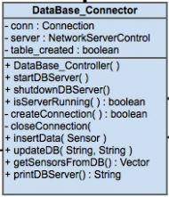
Starting the Database Server
shutdownDBServer()
startDBServer()
isServerRunning()

Slide 6
Create a New Database Connection
DataBase_Connector.java
Creates connection between program and database using predefined ‘username’ and ‘password’ for database.
Creates a new table with correct column id’s, names, and types, if one doesn’t already exist.

Slide 7
Create a New Database Connection
createConnection()
closeConnection()

Slide 8
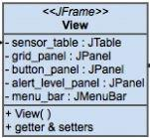
Create the GUI - Netbeans GUI Builder
View.form - View.java
- grid_panel : JPanel
holds all colored Grid_Cells
- sensor_table : JTable
holds all Sensors from database
- button_panel : JPanel
holds all Jbuttons
- alert_level_panel : JPanel
holds alertness level image color and average temperature
- menu_bar : JMenuBar
holds JMenuItems ex. Close, Export to Excel, Edit Sensor...
Basic “View.java”

Slide 9
Create the GUI - Basic Layout
One main JFrame
main_view : Jframe
One JMenuBar for the main Jframe
menu_bar : JMenuBar
Two main JPanels inside the main JFrame
left_panel : Jframe
right_panel : Jframe
All other components are inside of either left_panel or right_panel

Slide 10
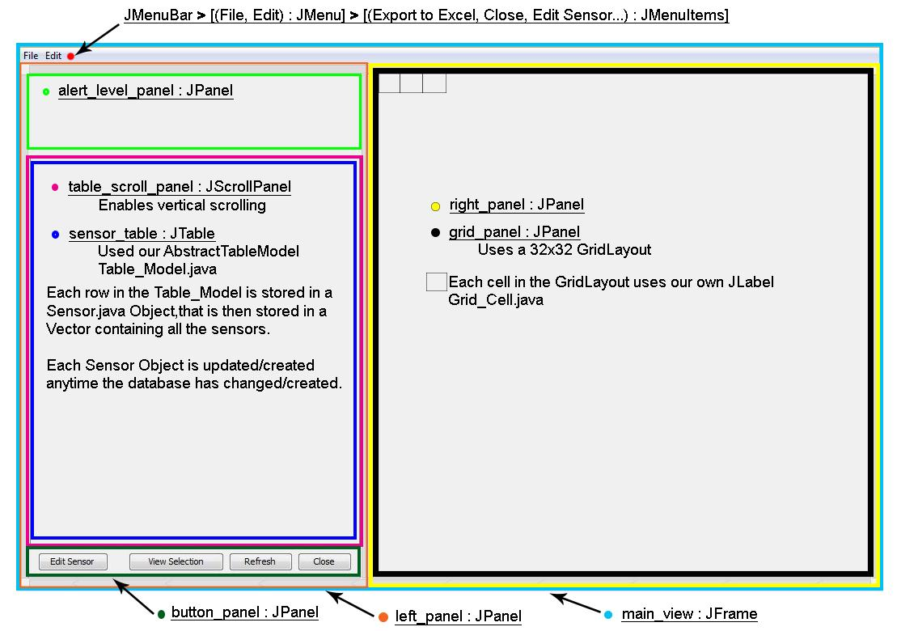
Create the GUI - View.form

Slide 11
Start Simulated Stream of Data
Update_Sensors_TimerTask.java
extends “java.util.TimerTask”
Uses scheduling at set intervals with “java.util.Timer” and our TimerTask, “Update_Sensors_TimerTask.java”
The tasks runs as long as the program is on.
Reads sensor data from a text file and imports them into the database; using SCRUM Anthony method.
Each time interval, reads a different file with 1024 lines

Slide 12
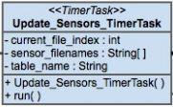
Start Simulated Stream of Data - TimerTask
Update_Sensors_TimerTask.java
sensor_filenames : String[]
- array of filenames containing sensor data
ex. “time0.0_Sensors.txt”, “time0.5_Sensors.txt”
current_file_index : int
- keeps track of which index in sensors_filenames
table_name : String
- the name of the database table to call: updateDB(String table_name, String file_name)
from DataBase_Connector.java

Slide 13
Read New Data at Set Interval
DataBase_Controller.java
After “updateDB()” is done the database has been changed.
The “updateDB()” calls “updateGridCellColors()” and “table_model.fireTableDataChanged()” which changes the grid colors to the appropriate colors and lets our view refresh its contents

Slide 14
Read New Data at Set Interval
DataBase_Controller.java
updateDB(String tble_name,String file_name)
- loads new sensor data from file
getSensorsFromDB()
- creates a new Vector of sensor data to be used with our Table_Model
Calls TimerTask.updateGridCellColors()
- sets each Grid_Cells new warning color
Calls table_model.fireTableDataChanged()
- refreshes our table of sensors view

Slide 15
Respond to user actions
Controller.java
Implements
- ActionListener for buttons and menu items
- MouseListener for grid box selection
Features
- Export current table to excel spreadsheet
- Query individual cells
- Sort table of sensor data by any value
- Refresh View

Slide 16
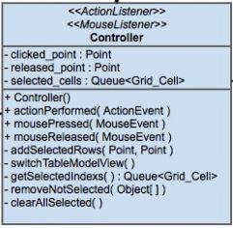
Respond to user actions
Controller.java
actionPerformed( ActionEvent )
- listens for any button pressed
mousePressed( MouseEvent )
mouseReleased( MouseEvent )
- Uses clicked_point : Point and released_point : Point to add the click-n-drag selected cells to selected_cells : Queue<Grid_Cell>

Slide 17
Requirements and Constraints
1. Visualization of data
2. Query/display application
3. Sensors
4. Fault tolerance
5. Adding/replacing sensors

Slide 18
Visualization of Data
JTable to display sensor data
JPanel:GridLayout filled will Colored Grid_Cells
- Green = Normal Conditions
- Yellow = Warning
- Orange = Warning, ex. Sensor Voltage Low
- Red = Fire
Two JLabels displaying Average Temp and Overall awareness color

Slide 19
Query/Display Application
Each Grid_Cell in the GridLayout is selectable:
- individually by mouse close
- range by mouse click-n-drag
- individually selected from JTable by button
- range by selected from JTable by button
Also, at any time you can export the current JTable data to an excel spreadsheet.

Slide 20
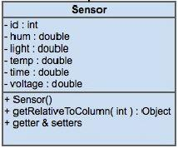
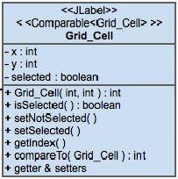
Sensors
Each sensor is stored in the database
Sensor Data View’s
- Sensor Object in the JTable
- Grid_Cell in the GridLayout

Slide 21
Sensors - Setting Grid Colors
if (voltage < 1.5)
Orange - Warning/Error
else if (temp <= avg_temp && lum <= avg_lum + 10% && hum <= avg_hum + 10%)
Green – Normal
else if (temp <= 40 degrees C && lum <= avg_lum + 10% && hum <= avg_hum + 10%)
Yellow – Alert
else
Red - Fire/Notify

Slide 22
Fault Tolerance
If a sensors voltage drops below a predefined value, (1.5 v) the Grid_Cell color is set to orange and is not included in the average temperature

Slide 23
Adding/Replacing Sensors
Edit Sensor Button
- Add new id’s not in the database or
- Edits there values in the database
- Then displays the changes

Slide 24
Netbeans GUI builder vs Hard Coded GUI
Better overall response times when using Netbeans GUI builder, but can be a pain to design with.
Hard Coded GUI, placement of swing components feels more absolute.

